Slide 1

BMS Bootcamp Coding Workshop
Emily Jones
7 September 2017
Notes:
Materials needed: laser pointer, laptop adapter, 1 ½ sheet for every 2 participants, 1 resources sheet per participant printed on colorful paper, printouts of “Hey Ya” and R markdown html
SET UP: open pointerfocus, repl.it in Chrome, and Rstudio
A few days in advance: load pre assignment instructions, heatmap paper, and resources on CLE + attach to email reminding them to do it and to bring laptops
The morning of: load R scripts, R environment with cancer, and heatmap exercise.html on CLE & ask students to download before session starts or during the break
Welcome to the last day of bootcamp! This will be the hardest (and hopefully most rewarding) session!
We’ve saved the longest, most interactive session for the last day. I’m Emily and I’ll be your pilot this morning; I met most of you yesterday, if not, hello. Let’s get going!

Slide 2
Workshop Outline
Why learn to code?
Coding in practice
Paper exercise
Python exercise
Bioinformatics pipeline
R Exercise
Resources
Notes:
Like all of the sessions so far, these slides are already online, so no need to take notes
This session is going to be very hands-on and participatory
Find a partner for this epic journey into code you are about to embark on

Slide 3
Workshop Outcomes
Think like a programmer
Get your feet wet
Become familiar with terms, concepts, languages, workflows, and resources
See coding as a useful, attainable skill
Teach yourself to code after this session
Notes:
What would you like to get out of this session?
Not going to learn how to code in 3 hours

Slide 4

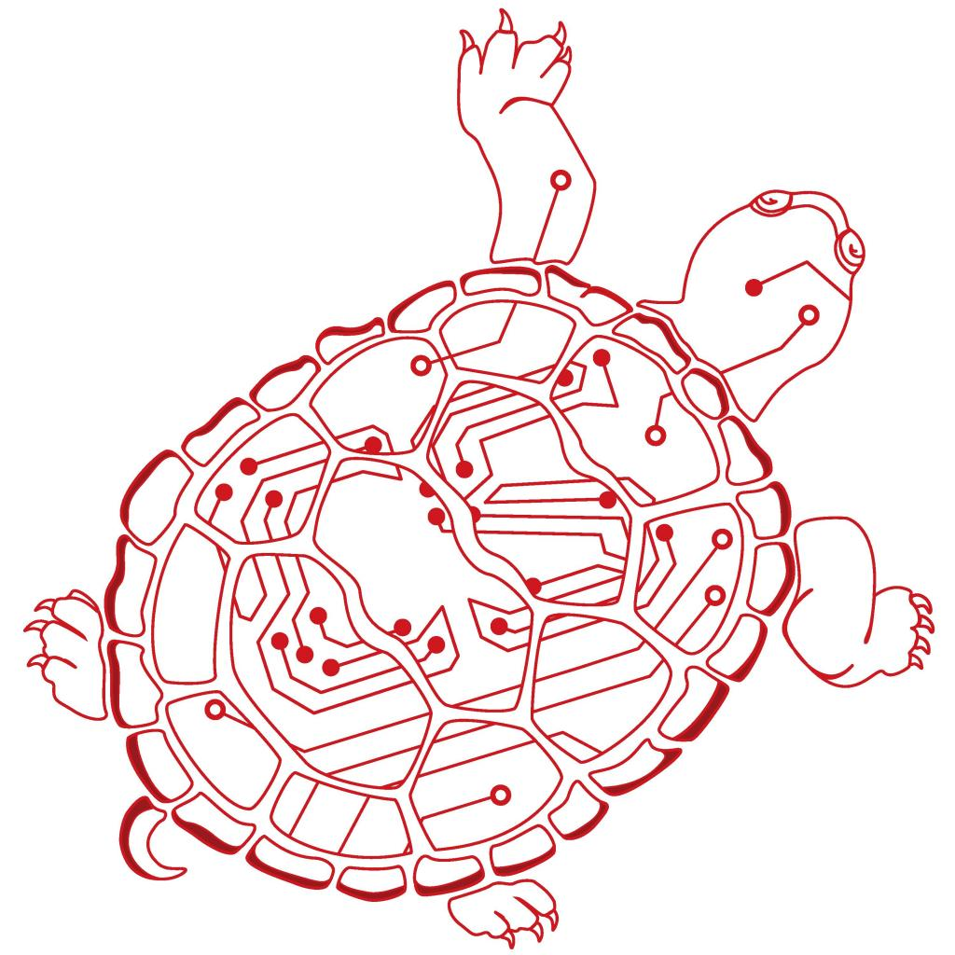

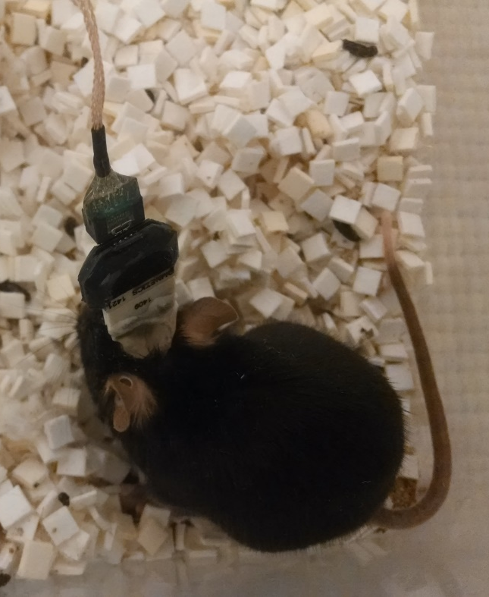
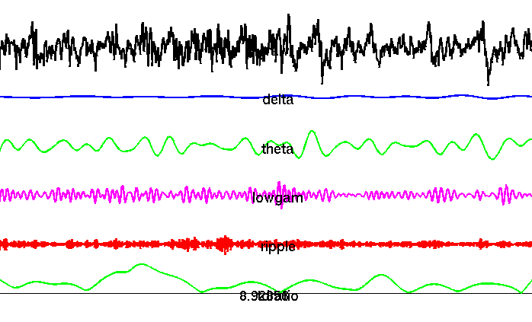
My Background
Notes:
Just to convince you I’m not talking out of my ass, here are my creds
Classes in 12 languages, self-taught 4 languages

Slide 5
Your Background
Languages you know:
How you learned:
Interests:
Notes:
If you said you’ve written any code before, please stand up => help others if this is too easy!
Some of this might seem silly, but it’s just to get you out of your shells. You guys are all smart enough to be here, so I promise I will make you work for it!

Slide 6
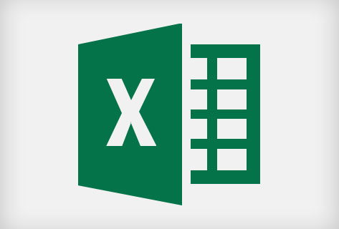
You already know how to code
=AVERAGE(A1:A10)
=SQRT(A1:A10)
Notes:
If you can write this, you already understand variables and functions, which are the grammar foundation of coding

Slide 7
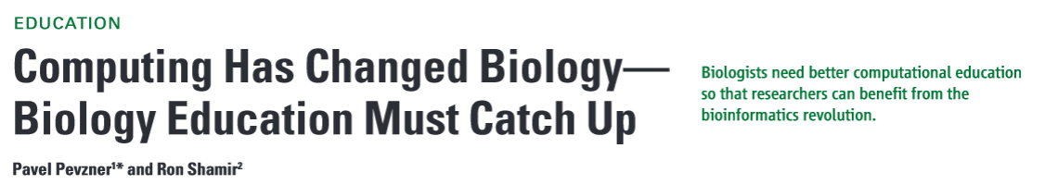
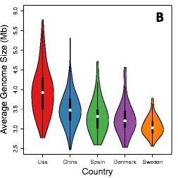
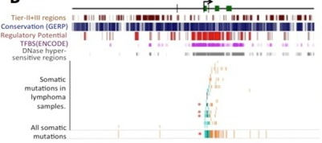
Why learn to code?
$
R01: NLM Express Research Grants in Biomedical Informatics
R21: Exploratory Innovations in Biomedical Computational Science and Technology
NIH NRSA: NHGRI, NIGMS, NLM
NSF GRFP
Notes:
Tide shifting towards everyone having basic coding knowledge
Get an edge in rotations (the words “I have funding” (like we discussed yesterday) and “I know how to code” opens a lot of doors)
Make cool plots
Funding! (that’s how I got my NSF)

Slide 8


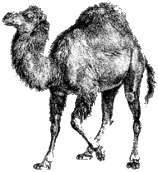


Coding in Practice: Languages
Scripting: Python Ruby Perl
e.g. read information from a text file of GWAS results
Statistics:
e.g. cluster gene expression by similarity
Signal & image processing: MATLAB
e.g. filter & process raw EEG data
Choosing a language:
Ease of use/your own knowledge
Packages
Community
Using a language:
Install the language
Install the IDE
Find & install a package
Notes:
3 basic language types you’ll encounter in biology
Using a language: you’ve already done all 3 for your homework

Slide 9
Coding in Practice: A Simple Script, Start to Finish
Sample problem: You have run a microarray on your sample tissue and want to compare expression of different genes.
Learning how to write the script is similar to learning how to do the assay.
Choose your algorithm: what assay should I use?
Choose your language: which protocol should I use?
Prototyping: test your assay to make sure it works
Debugging: analyze your results before you start the next round
Keep records
Expression clustering
R, Hierarchical clustering (hclust)
Run your script on fake data
Microarray
Tissue IHC (Abcam kit)
Run microarray with positive & negative controls
Don’t wait until your script is finished to start testing the output
Document your code, record bugs and results in your lab notebook
Don’t run an entire paper’s worth of microarrays just to discover the antibody doesn’t work
Record each sample, assay, and results in your lab notebook
Notes:
2.how would you do this? (ask someone in lab, look up a paper)
3. if I load 50ug of BSA, I get a signal proportional to that
5. How would you do this? Any ideas on how you do this for code? Save the version of the code you use to generate analysis for your papers!
QUESTIONS?

Slide 10
FizzBuzz Test
With a partner, in pseudocode, describe a function called “FizzBuzz.”
This function does the following:
Takes a whole number “x”
Prints all the numbers between 1 and x in order, BUT
If the number is a multiple of 3, then print “Fizz” instead of the number AND
If the number is a multiple of 5, then print “Buzz” instead of the number
function FizzBuzz(x):
________
for i = a to b
________
if (condition) then
________
if (condition) then
________
else
________
Notes:
25:00
RAISE YOUR HAND if you need more time
Write out on the board: 1 2 Fizz 4 Buzz
I’m going to make it super easy by giving you all the tools you need
Remember, functions are things like AVERAGE in Excel
Here you can do something with your VARIABLE x or i; ; for i = 1 to 5 print “Hello”
Pseudocode is just transliterating from English to kind-of-English; you can write things like if(x rhymes with “banana”)
This is where it gets tricky…logic it out with your partner. Try setting x equal to different values and running your fake script.

Slide 11
FizzBuzz Test: Tracing
Swap papers with another pair.
Let x = 20. Write down what their function outputs, talking through each iteration of the loop as you go.
Pseudocode:
function FizzBuzz(x):
for i = 1 to x
if (i is divisible by 3 OR by 5) then
if (i is divisible by 3) then
print “Fizz”
if (i is divisible by 5) then
print “Buzz”
else
print i
Trace:
1
2
Fizz
4
Buzz
Fizz
7
8
Fizz
Buzz
11
Fizz
13
14
FizzBuzz
16
17
Fizz
19
Buzz
Notes:
Congratulations, you have solved your first coding interview challenge!
QUESTIONS?

Slide 12
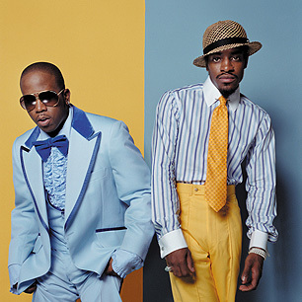
Let’s Learn Python in 10 Minutes Flat
Go to repl.it and select Python3
Notes:
40:00
Today we are going to become songwriters, and like all good songwriters we are going to start by stealing from someone better
Who can tell me who these fabulous gentlemen are? What song are they most famous for?
If you’re not familiar with this song, I weep for your childhood
if you know how to do it, go ahead, otherwise follow along
“a polaroid picture”, “a bottle of soda”, “the vortexer is broken”, “a salt shaker”

Slide 13
Let’s Learn Python in 10 Minutes Flat
#prints the bridge of "Hey Ya"
#input: string shakeitlike
def heyya
for i in range
if i%4==3:
print("shake it like " + shakeitlike)
else: #all other lines
print("shake it, shake shake it")
return "written by the BMS Bootcamp 2018 Class"
(shakeitlike):
(0,4):
#every fourth line
Topics we covered:
Function
Print
Loop
Zero-indexing
Documentation
Tabs
Variables
If..Then…
Parameters
Types
Return
Notes:
QUESTIONS?

Slide 14

10 Minute Break
Notes:
55:00
TURN ON POINTERFOCUS (turn off keyboard)
Download R scripts, R env, R html if they haven’t already

Slide 15
Collaborating Through Code
Bad Code:
thing1 = makestuff(10)
thing2 = makestuff(20)
thing3 = makestuff(30)
if(thing2>thing1) {print(thing2)}
if(thing3>thing2) {print(thing3)}
Good Code:
Useful variable & function names
Modular & reusable (don’t repeat yourself)
Readable
Documented & reproducible
Notes:
Modular: loops and functions
Readable: like how you make a paper readable, with tabs & lots of blank lines
Documented: how would you document the above code?
Reproducible: how would you make sure someone could reproduce your experiment?

Slide 16
Bioinformatics Processing Pipeline
Platform-specific raw inputs
Clustering (see the forest for the trees)
Modeling (use data as a tool to answer new questions)
Preprocessing (bathe your data)
Visualization
Gene Ontology (extract meaning)
Filter (remove bad samples)
Statistics (what’s significant?)
Find targets & follow up (show relevance)
Batch effects (compare across expts)
Normalize (divide by mean)
Notes:
Not every pipeline contains all of these steps
1. Illumina 450k Methylation Array
2. background correction (like Westerns)
4. experiments run separately can’t be compared directly (like Westerns)
5. divide expression values by the mean for the sample
7. heatmaps, PCA plots, intensity plots, etc (we will do a heatmap)
How could we make this hypothesis driven & not dependent for aims?
sample data set: -1, 0.01, 007, 3x10^3 6x10^3, 6x10^6

Slide 17
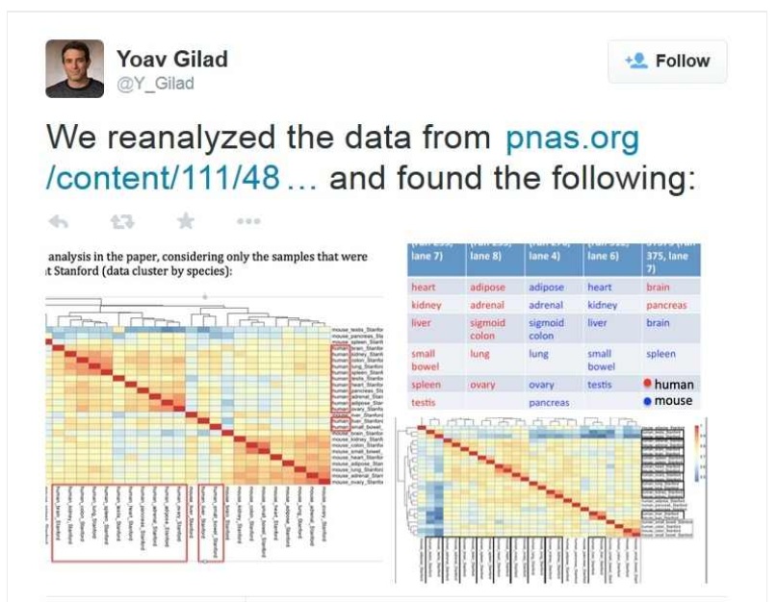
Good Processing is Important
“These effects can arise from variations in the way different batches of samples are handled, which can affect the data and be mistaken for biological effects. Gilad concluded that the analysis involved five different sequencing runs to analyse RNA. One of those runs included both mouse and human tissues, but the other four contained samples from only mouse or only human tissues. He argues that any differences in the runs themselves could have exaggerated the differences between the two species. According to Gilad’s reanalysis…removing possible batch effects from the data reverses the conclusion of the PNAS paper — such that the gene-expression data cluster by tissue and not by species.”
Notes:
http://www.nature.com/news/potential-flaws-in-genomics-paper-scrutinized-on-twitter-1.17591
QUESTIONS?

Slide 18
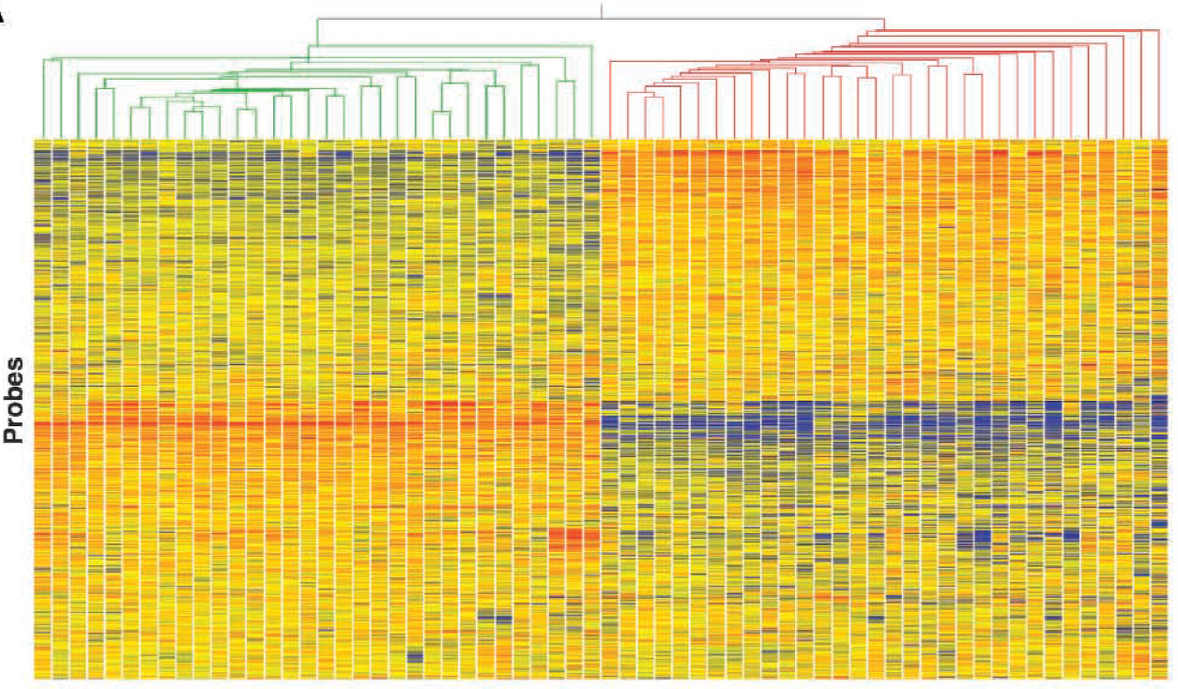
Let’s Learn R in 30 Minutes Flat
Notes:
75:00
RAISE YOUR HAND if you need more time
If you already know how to do this, help others!
IDE introduction: console, scripts, history, environment, packages, files, plots, saving plots, manually installing/loading packages, manually setting environment, ?help
http://dss.princeton.edu/training/RStudio101.pdf
the original teaching paper: http://learnmem.cshlp.org/content/11/3/253/F2.expansion.html

Slide 19
Pop Quiz!
www.socrative.com
Student login, room: BMSBOOTCAMP
Notes:
110:00
RAISE YOUR HAND if you need more time
QUESTIONS?

Slide 20
Campus Resources
Library: https://www.library.ucsf.edu/help/classes
Cell Hackers: https://www.facebook.com/cellhackers
Bioinformatics Core: http://cores.ucsf.edu/bioinformatics-analysis.html
BMI Program Courses: http://bioinformatics.ucsf.edu/degree-program/courses
Mini-courses:
Intro to Bioinformatics and Computer Programming for Biologists
Practical Bioinformatics with Programming
Scientific Software Development
…or others, depending on the year
Notes:
coding is a continual learning process
Rave reviews about Katie Pollard’s fall course in particular

Slide 21
Programming and Pizza: Python/R
http://bit.ly/programmingandpizza
Thursday, September 21, 4-6pm
The Hub, Mission Hall 1302

Slide 22
Resources
Handout online, including…
Challenges to expand what we’ve learned here
Campus resources
General
Python guides & courses
R guides & courses
Package managers (if you want to get fancy)
Also on the CLE website: slide deck, heyya.py, R markdown
Contact me at emily.jones@ucsf.edu
Notes:
Hold the resources sheet aloft
1. I know they might look like doozies, but you can do them! I believe in you!

Slide 23
Workshop Outcomes
Think like a programmer
Get your feet wet
Become familiar with terms, concepts, languages, workflows, and resources
See coding as a useful, attainable skill
Teach yourself to code after this session
Notes:
What do you know now that you didn’t know before?
Thank you to my wandering debuggers [NAME THEM}
But most importantly…

Slide 24
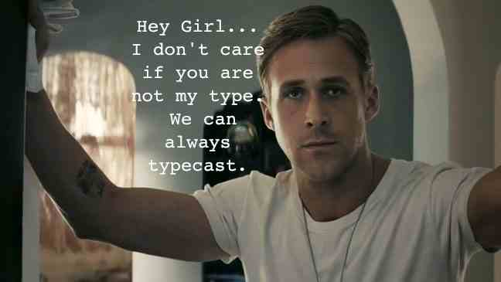
programmerryangosling.tumblr.com
Notes:
This is literally the only reason I taught you guys what typecasting is.
I have included Ryan Gosling in my teaching materials. This is my greatest achievement.

Slide 25

Next Steps
Think about what you’d like to accomplish
Pick 1 language
Pick 1 introductory resource
Put it on your calendar
Find other students who also want to learn and try a challenge with them
BONUS: pick 1 course
Notes:
Eg write a simple script just to say you can, explore a new field of data
Python or R, MATLAB if appropriate
Even if you already know how to code! I’m currently taking 1 graduate course and a series of coursera courses and I have a degree in this shit
Or you’ll never do it! I know we just gave you a ton of things to do over the past 3 days, but trust me on this. The reason we made this bootcamp is to teach you all the things we wished we had learned in our first year here.
Eh, table buddies? New best friends?
QUESTIONS?

